Slide 1
OEM Colour Code Locations
Model Information with Label Examples

Slide 2

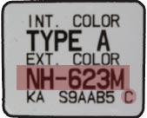
ACURA
MODEL |  |  |  | POSITION OF COLOUR LABEL
ALL MODELS |  |  |  | ON THE FRONT DOOR SHUTS
COLOUR CODE

Slide 3
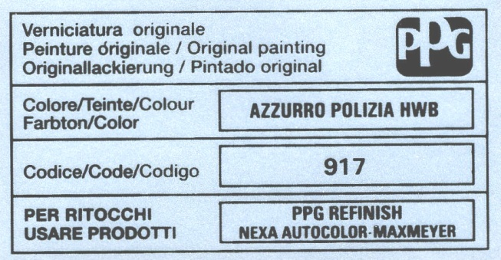
ALFA ROMEO
MODEL |  |  |  | POSITION OF COLOUR LABEL
BRERA - MITO - GTV - SPIDER GIULIETTA |  |  |  | ON THE ENGINE COMPARTMENT COVER
159 - 147 - MI.TO |  |  |  | ON THE TAILGATE OF LUGGAGE COMPARTMENT
COLOUR CODE

Slide 4
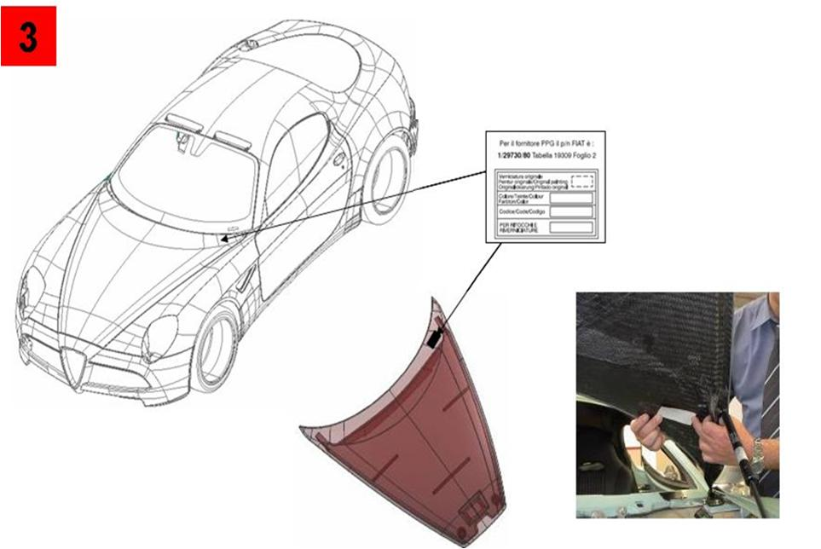
ALFA ROMEO 8C
 |  |  |  |  |  | PPG COLOR REFERENCE POSITION PLATE GLUED ON BONNET (see picture)

Slide 5

AMERICAN MOTORS
MODEL |  |  |  | POSITION OF COLOUR LABEL
“AMC” MODELS |  |  |  | ON THE FRONT DOOR SHUTS
“AMC” JEEPS |  |  |  | INSIDE THE ENGINE COMPARTMENT (FIREWALL)
COLOUR CODE
PICTURE NOT CURRENTLY AVAILABLE

Slide 6

ASTON MARTIN
MODEL |  |  |  | POSITION OF COLOUR LABEL
ALL MODELS |  |  |  | UNDER THE BONNET
COLOUR CODE
PICTURE NOT CURRENTLY AVAILABLE

Slide 7
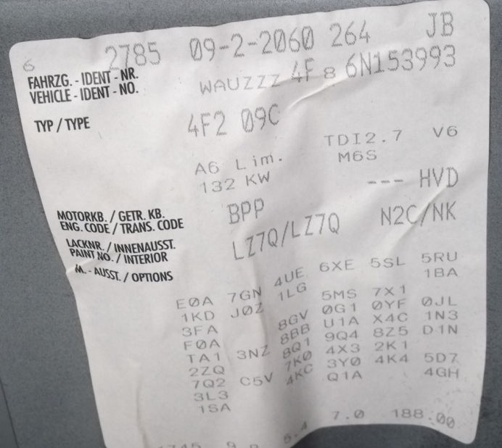
AUDI
MODEL |  |  |  | POSITION OF COLOUR LABEL
ALL MODELS |  |  |  | INSIDE THE LUGGAGE COMPARTMENT
COLOUR CODE

Slide 8
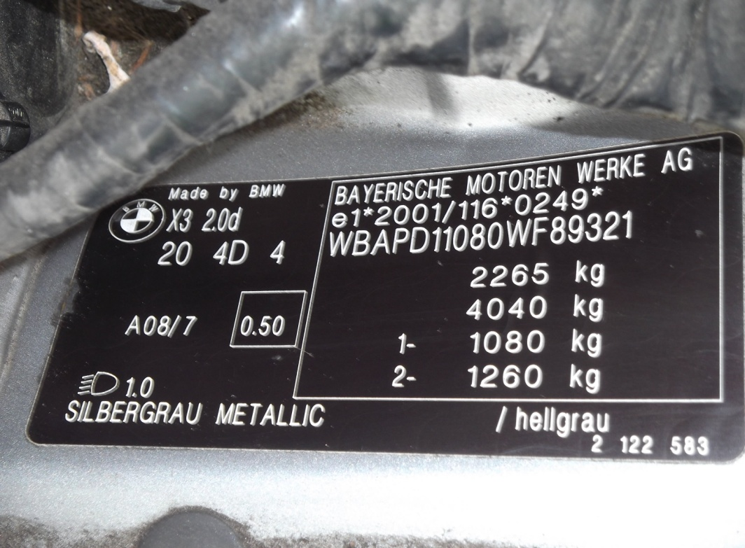
BMW
MODEL |  |  |  | POSITION OF COLOUR LABEL
1 - 3 - 5 - 6 - 7 |  |  |  | ON THE COLUMN / POST FRONT DOOR
X3 - X5 - Z4 |  |  |  | INSIDE THE ENGINE COMPARTMENT
COLOUR CODE

Slide 9

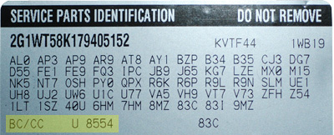
BUICK
MODEL |  |  |  | POSITION OF COLOUR LABEL
ALL MODELS |  |  |  | ON THE SERVICE PARTS IDENTIFICATION STICKER
COLOUR CODE

Slide 10

CADILLAC
MODEL |  |  |  | POSITION OF COLOUR LABEL
ALL MODELS |  |  |  | ON THE SERVICE PARTS IDENTIFICATION STICKER
COLOUR CODE

Slide 11
CHEVROLET
MODEL |  |  |  | POSITION OF COLOUR LABEL
AVEO - CAPTIVA- MATIZ - SPARK EPICA - LACETTI - NUBIRA KALOS |  |  |  | INSIDE THE ENGINE COMPARTMENT
HRR |  |  |  | IN THE GLOVE COMPARTMENT
“ALSO CHECK” |  |  |  | ON THE DOOR SHUTS
COLOUR CODE
HRR
LABEL

Slide 12
CHRYSLER
MODEL |  |  |  | POSITION OF COLOUR LABEL
NEON - SEBRING - STRATUS CABRIO - VOYAGER |  |  |  | INSIDE THE ENGINE COMPARTMENT
PT CRUISER |  |  |  | ON THE INSIDE OF THE FRONT BUMPER
CHEROKE |  |  |  | ON THE INSIDE OF THE REAR BUMPER
COLOUR CODE

Slide 13
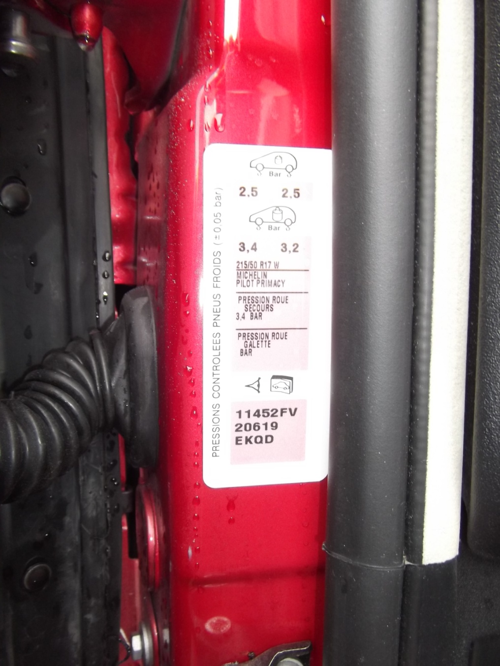
CITROEN
MODEL |  |  |  | POSITION OF COLOUR LABEL
C-CROSSER - NEMO - JUMPER |  |  |  | INSIDE THE ENGINE COMPARTMENT
C2-C3-C3 PLURIEL - C3 PICASSO C4 – C4 PICASSO - C5 – C8 - DS3 JUMPY |  |  |  | ON THE FRONT DOOR SHUTS
C1 |  |  |  | INSIDE OF COLUMN, RIGHT SIDE DOOR
COLOUR CODE

Slide 14
DACIA
MODEL |  |  |  | POSITION OF COLOUR LABEL
ALL MODELS |  |  |  | INSIDE BOOT, ENGINE COMPARTMENT OR INSIDE DOOR SHUTS
COLOUR CODE

Slide 15

DAEWOO
MODEL |  |  |  | POSITION OF COLOUR LABEL
ALL MODELS |  |  |  | INSIDE THE ENGINE COMPARTMENT
COLOUR CODE
PICTURE NOT CURRENTLY AVAILABLE

Slide 16
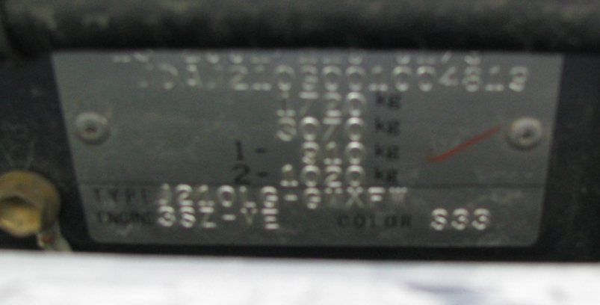
DAIHATSU
MODEL |  |  |  | POSITION OF COLOUR LABEL
CUORE - MATERIA - TERIOS - YRV SIRION - COPEN |  |  |  | INSIDE THE ENGINE COMPARTMENT
“ALSO CHECK” |  |  |  | IN DOOR SHUTS OR INSIDE FRONT BUMPER
COLOUR CODE

Slide 17

DATSUN
MODEL |  |  |  | POSITION OF COLOUR LABEL
ALL MODELS |  |  |  | INSIDE THE ENGINE COMPARTMENT
COLOUR CODE
PICTURE NOT CURRENTLY AVAILABLE

Slide 18

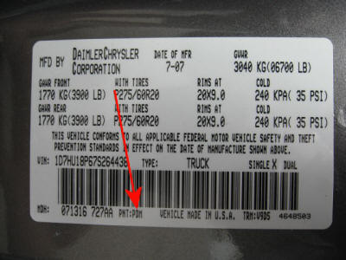
DODGE
MODEL |  |  |  | POSITION OF COLOUR LABEL
ALL MODELS 2007 - 2008 |  |  |  | ON THE FRONT DOOR SHUTS
CALIBER, CHALLENGER, NITRO, VIPER |  |  |  | ON THE FRONT DOOR SHUTS
SHADOW, SPIRIT, SPRINTER |  |  |  | UNKNOWN
ALL OTHER MODELS |  |  |  | INSIDE THE ENGINE COMPARTMENT
COLOUR CODE

Slide 19

EAGLE
MODEL |  |  |  | POSITION OF COLOUR LABEL
ALL MODELS |  |  |  | INSIDE THE ENGINE COMPARTMENT
COLOUR CODE
PICTURE NOT CURRENTLY AVAILABLE

Slide 20

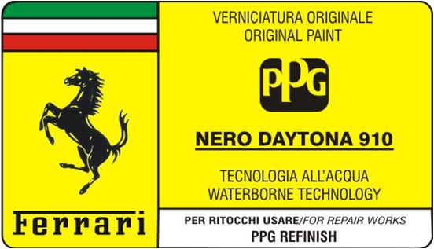
FERRARI
MODEL |  |  |  | POSITION OF COLOUR LABEL
ALL MODELS |  |  |  | INSIDE THE ENGINE COMPARTMENT (UNDER BONNET) OR INSIDE LUGGAGE COMPARTMENT
COLOUR CODE

Slide 21
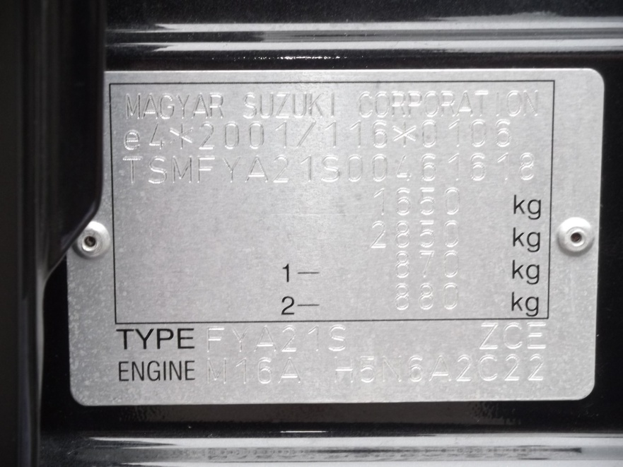
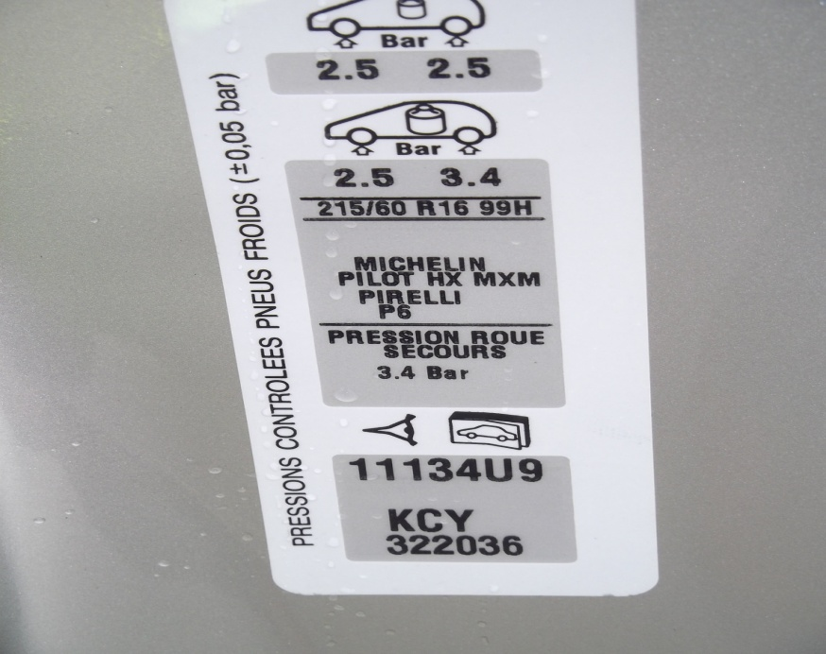
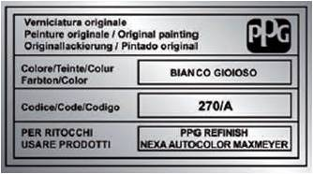
FIAT
MODEL |  |  |  | POSITION OF COLOUR LABEL
BRAVO - CROMA - PUNTO |  |  |  | ON THE ENGINE COMPARTMENT COVER (UNDER BONNET)
DOBLO' - DUCATO - SCUDO QUBO - SEDICI - IDEA |  |  |  | INSIDE THE ENGINE COMPARTMENT
STILO - 500 - 600 - PANDA MULTIPLA - GRANDE PUNTO |  |  |  | INSIDE THE REAR / LUGGAGE COMPARTMENT
NUOVO SCUDO - ULYSSE |  |  |  | ON THE FRONT DOOR EDGE
SEDICI - STRADA |  |  |  | ON THE INSIDE EDGE OF FRONT DOOR
FIAT SEDICI COLOUR CODE SUZUKI
FIAT ULYSSE COLOUR CODE PSA

Slide 22
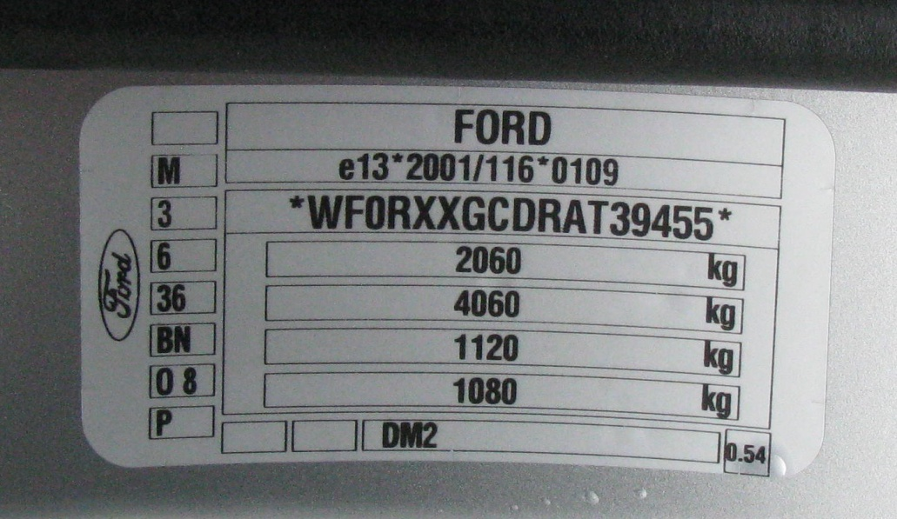
FORD
MODEL |  |  |  | POSITION OF COLOUR LABEL
FIESTA - KA - FUSION - FOCUS S MAX - C MAX - KUGA FOCUS COUPE'(PININFARINA) |  |  |  | INSIDE DOOR SHUTS
“ALSO CHECK” |  |  |  | INSIDE ENGINE COMPARTMENT
COLOUR CODE

Slide 23

GEO
MODEL |  |  |  | POSITION OF COLOUR LABEL
ALL MODELS |  |  |  | ON THE SERVICE PARTS IDENTIFICATION STICKER
COLOUR CODE
PICTURE NOT CURRENTLY AVAILABLE

Slide 24
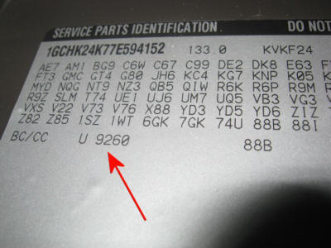
GMC
MODEL |  |  |  | POSITION OF COLOUR LABEL
SAFARI, SAVANA |  |  |  | ON THE DOOR FACE
ALL OTHER MODELS |  |  |  | IN THE GLOVE BOX
“ALSO CHECK” |  |  |  | DOOR SHUTS AND ENGINE COMAPRTMENT
COLOUR CODE

Slide 25
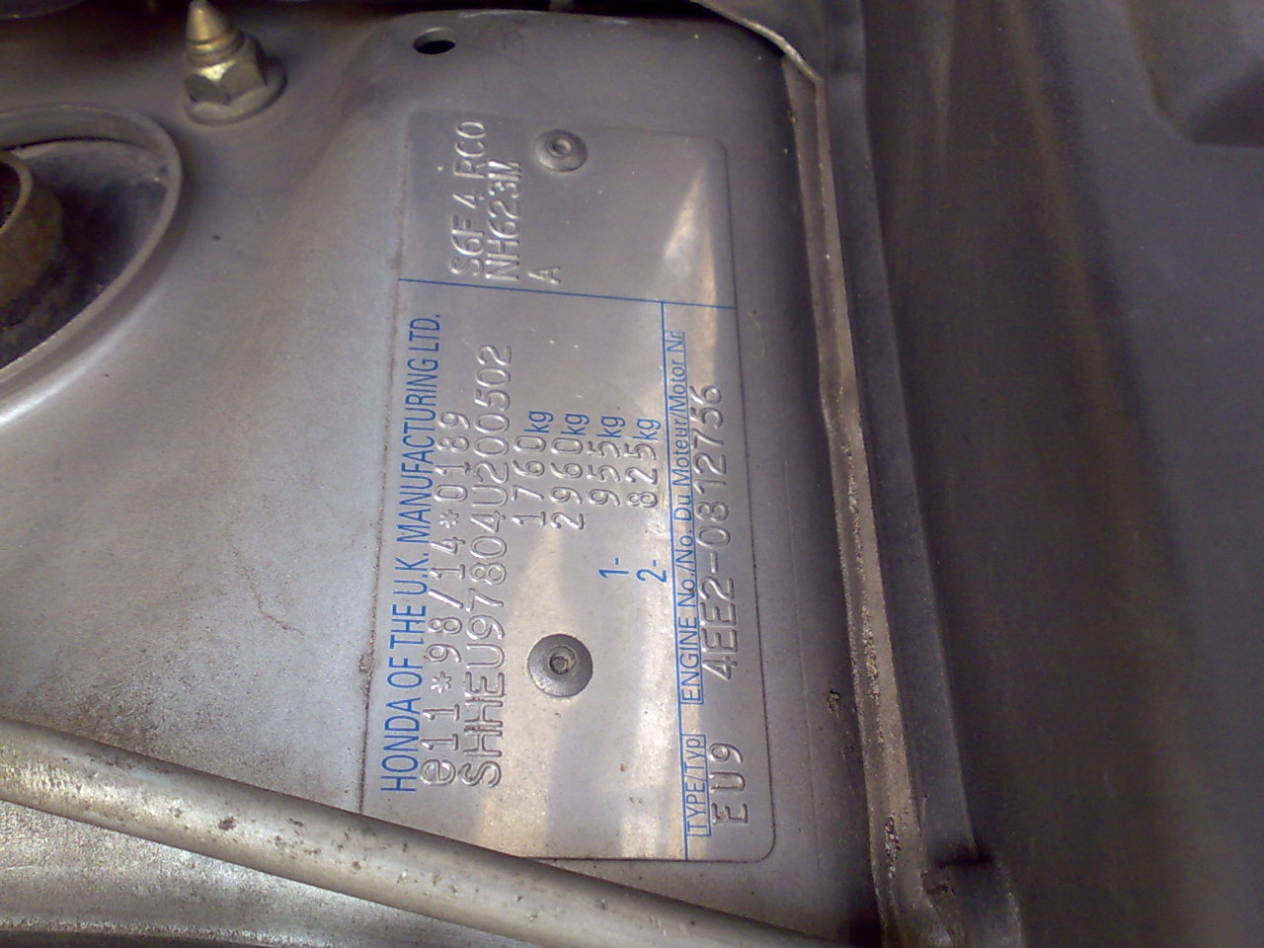
HONDA
MODEL |  |  |  | POSITION OF COLOUR LABEL
ACCORD - JAZZ - CR V - FR V S2000 - STREAM CIVIC |  |  |  | INSIDE THE ENGINE COMPARTMENT
CIVIC - INSIGHT - LOGO - S2000 NSX |  |  |  | ON THE COLUMN / POST FRONT DOOR
COLOUR CODE

Slide 26
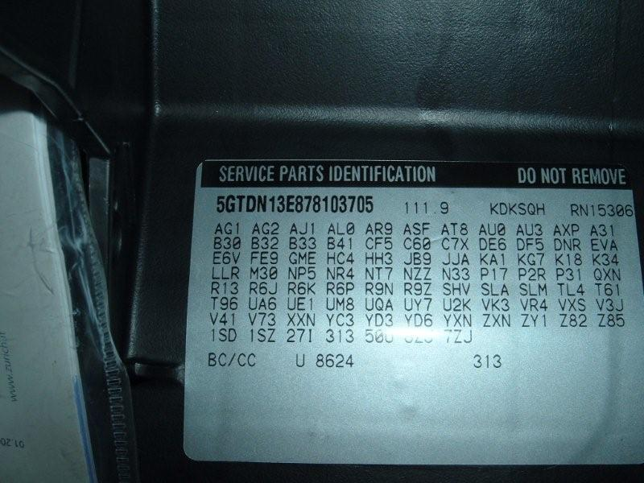
HUMMER
MODEL |  |  |  | POSITION OF COLOUR LABEL
ALL MODELS |  |  |  | INSIDE THE GLOVE COMPARTMENT
COLOUR CODE
(GMNA)

Slide 27
HYUNDAI
MODEL |  |  |  | POSITION OF COLOUR LABEL
ACCENT - ATOS PRIME - COUPE' LANTRA - TRAJET – TERRACAN SONICA |  |  |  | INSIDE THE ENGINE COMPARTMENT
I10 - I30 - IX35 - IX55 - SANTA FE TUCSON - MATRIX |  |  |  | ON THE COLUMN / POST FRONT DOOR
I20 |  |  |  | ON THE EDGE OF FRONT DOOR
COLOUR CODE

Slide 28

INFINITI
MODEL |  |  |  | POSITION OF COLOUR LABEL
EX35, G37, M35, N40, QX56. Some M45 models |  |  |  | ON THE FRONT DOOR COLUMN
ALL OTHER MODELS Some M45 models |  |  |  | IN THE ENGINE COMPARTMENT (FIREWALL)
COLOUR CODE
PICTURE NOT CURRENTLY AVAILABLE

Slide 29

ISUZU
MODEL |  |  |  | POSITION OF COLOUR LABEL
HOMBRE - OASIS |  |  |  | INSIDE DOOR SHUTS
AMIGO - AXIOM - RODEO VEHICROSS |  |  |  | INSIDE THE ENGINE COMPARTMENT
ASCENDER |  |  |  | INSIDE GLOVE BOX
COLOUR CODE
PICTURE NOT CURRENTLY AVAILABLE

Slide 30
JAGUAR
MODEL |  |  |  | POSITION OF COLOUR LABEL
XJ |  |  |  | INSIDE THE ENGINE COMPARTMENT
X TYPE - S TYPE - XJ - XF – XK |  |  |  | ON THE COLUMN / POST FRONT DOOR
COLOUR CODE

Slide 31

JEEP
MODEL |  |  |  | POSITION OF COLOUR LABEL
COMMANDER, COMPASS, LIBERTY, PATRIOT |  |  |  | ON THE FRONT DOOR COLUMN
CHEROKEE, COMANCHE, GRAND CHEROKEE, WAGONEER |  |  |  | IN THE ENGINE COMPARTMENT
WRANGLER |  |  |  | UNDER THE FRONT SEAT
COLOUR CODE
PICTURE NOT CURRENTLY AVAILABLE

Slide 32
KIA
MODEL |  |  |  |  | POSITION OF COLOUR LABEL
CARNIVAL - CARENS - SORENTO SPORTAGE - SOUL |  |  |  |  | INSIDE THE ENGINE COMPARTMENT
SOUL |  |  |  |  | ON THE INSIDE COLUMN RIGHT SIDE DOOR
CARNIVAL - CEE'D - PICANTO RIO - SPORTAGE - VENGA |  |  |  |  | ON THE COLUMN / POST FRONT DOOR
COLOUR CODE

Slide 33

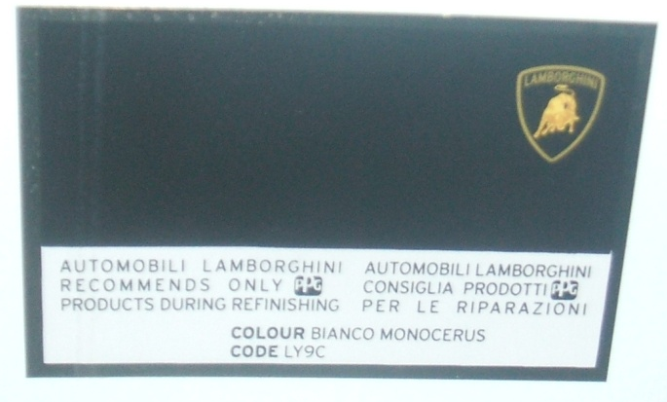
LAMBORGHINI
MODEL |  |  |  | POSITION OF COLOUR LABEL
GALLARDO - MURCIELAGO |  |  |  | INSIDE THE ENGINE COMPARTMENT COVER
COLOUR CODE

Slide 34
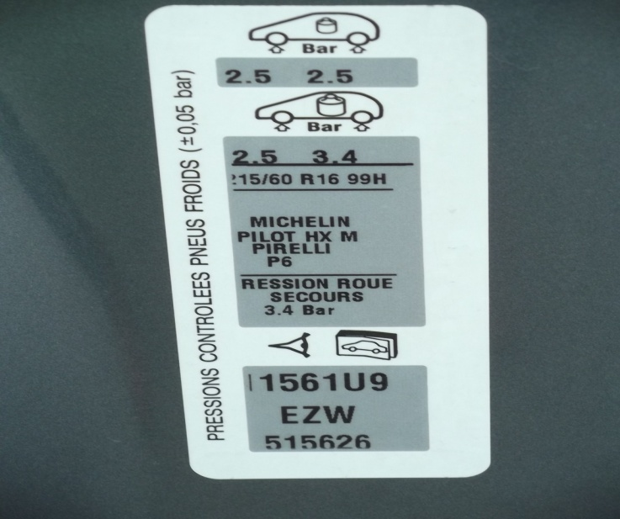
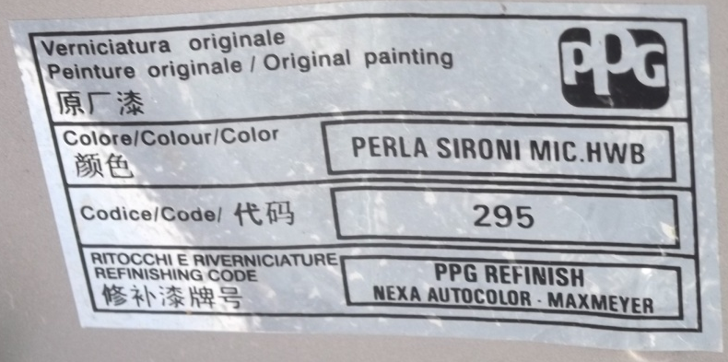
LANCIA
MODEL |  |  |  | POSITION OF COLOUR LABEL
DELTA - MUSA |  |  |  | INSIDE THE ENGINE COMPARTMENT COVER
Y |  |  |  | INSIDE THE LUGGAGE COMPARTMENT
PHEDRA |  |  |  | ON EDGE OF FRONT DOOR
LANCIA PHEDRA - COLOUR CODE PSA

Slide 35
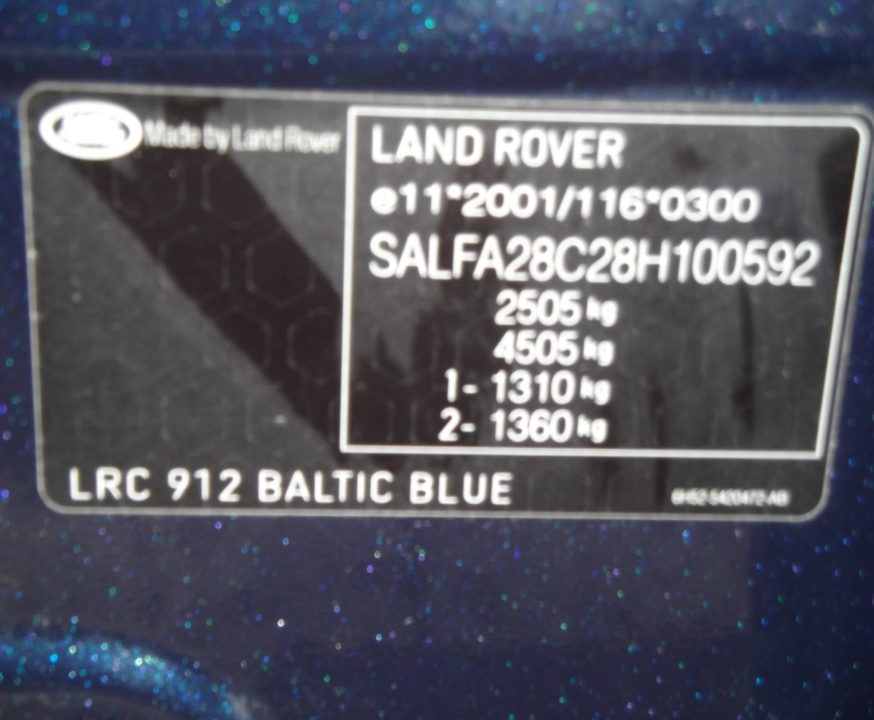
LAND ROVER
MODEL |  |  |  | POSITION OF COLOUR LABEL
RANGE ROVER - RANGE ROVER SPORT - DISCOVERY |  |  |  | INSIDE THE ENGINE COMPARTMENT
FREELANDER |  |  |  | ON THE COLUMN OF FRONT DOOR
COLOUR CODE

Slide 36

LEXUS
MODEL |  |  |  | POSITION OF COLOUR LABEL
ALL MODELS |  |  |  | ON THE FRONT DOOR COLUMN
COLOUR CODE
PICTURE NOT CURRENTLY AVAILABLE

Slide 37

LINCOLN
MODEL |  |  |  | POSITION OF COLOUR LABEL
ALL MODELS |  |  |  | ON THE FRONT DOOR COLUMN
COLOUR CODE
PICTURE NOT CURRENTLY AVAILABLE

Slide 38

LOTUS
MODEL |  |  |  | POSITION OF COLOUR LABEL
ALL MODELS |  |  |  | IN THE ENGINE COMPARTMENT
COLOUR CODE
PICTURE NOT CURRENTLY AVAILABLE

Slide 39

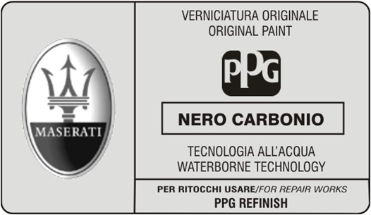
MASERATI
MODEL |  |  |  | POSITION OF COLOUR LABEL
ALL MODELS |  |  |  | INSIDE THE ENGINE COMPARTMENT (UNDER BONNET)
COLOUR DESCRIPTION

Slide 40
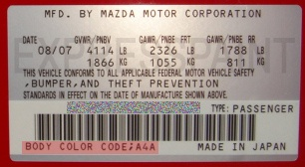
MAZDA
MODEL |  |  |  | POSITION OF COLOUR LABEL
ALL MODELS BEFORE 1997 |  |  |  | ON THE FRONT DOOR SHUTS
ALL MODELS AFTER 1997 |  |  |  | INSIDE THE ENGINE BAY
COLOUR CODE

Slide 41
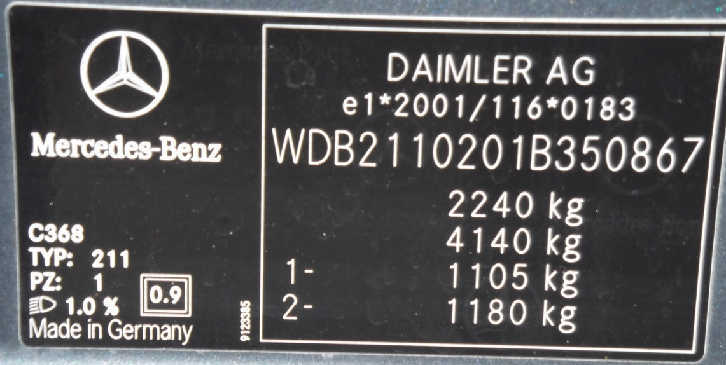
MERCEDES
MODEL |  |  |  | POSITION OF COLOUR LABEL
ALL MODELS |  |  |  | ON THE FRONT DOOR COLUMN
“ALSO CHECK” |  |  |  | INSIDE ENGINE COMPARTMENT
COLOUR CODE

Slide 42

MERCURY
MODEL |  |  |  | POSITION OF COLOUR LABEL
ALL MODELS |  |  |  | ON THE FRONT DOOR COUMN
COLOUR CODE
PICTURE NOT CURRENTLY AVAILABLE

Slide 43

MINI
MODEL |  |  |  | POSITION OF COLOUR LABEL
ALL MODELS UP TO 2007 |  |  |  | INSIDE THE ENGINE COMPARTMENT
ALL MODELS AFTER 2007 |  |  |  | ON THE FRONT DOOR COLUMN
COLOUR CODE
COLOUR CODE
COLOUR CODE

Slide 44
MITSUBISHI
MODEL |  |  |  | POSITION OF COLOUR LABEL
COLT - LANCER - OUTLANDER PAJERO - L200 - PAJERO PININ |  |  |  | INSIDE THE ENGINE COMPARTMENT
COLT - COLT CZC |  |  |  | ON THE FRONT DOOR COLUMN
CANTER |  |  |  | ON THE FRONT DOOR SHUTS
COLOUR CODE

Slide 45
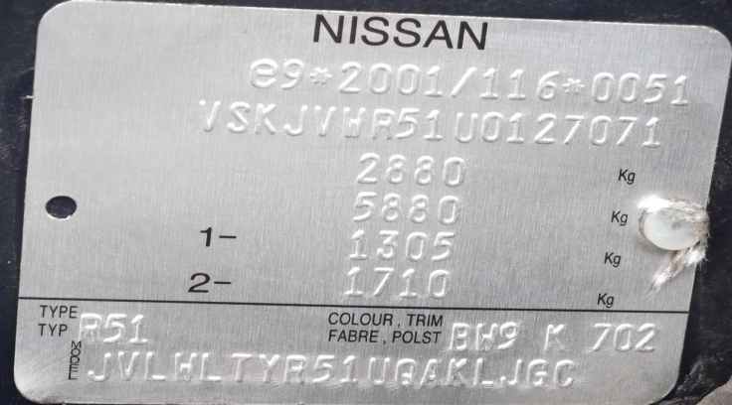
NISSAN
MODEL |  |  |  | POSITION OF COLOUR LABEL
PIXIO - CUBE - JUKE - 370Z GT R - MURANO |  |  |  | NOT KNOWN
NOTE - MICRA – QASHQAI |  |  |  | ON THE FRONT DOOR COLUMN
PATHFINDER - X TRAIL - PATROL |  |  |  | INSIDE THE ENGINE COMPARTMENT
COLOUR CODE

Slide 46

OLDSMOBILE
MODEL |  |  |  | POSITION OF COLOUR LABEL
ALL MODELS |  |  |  | ON THE SERVICE PARTS IDENTIFICATION STICKER
COLOUR CODE
PICTURE NOT CURRENTLY AVAILABLE

Slide 47
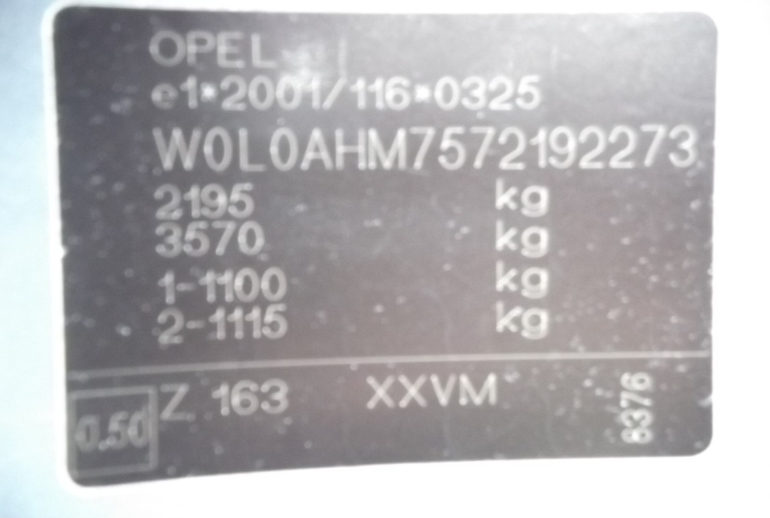
OPEL
MODEL |  |  |  | POSITION OF COLOUR LABEL
ASTRA - AGILA - CORSA - INSIGNA - VECTRA - ZAFIRA |  |  |  | ON THE COLUMN / POST FRONT DOOR
ANTARA - CORSA - MERIVA - SIGNUM |  |  |  | INSIDE THE ENGINE COMPARTMENT
“ALSO CHECK” |  |  |  | INSIDE THE BOOT
COLOUR CODE

Slide 48
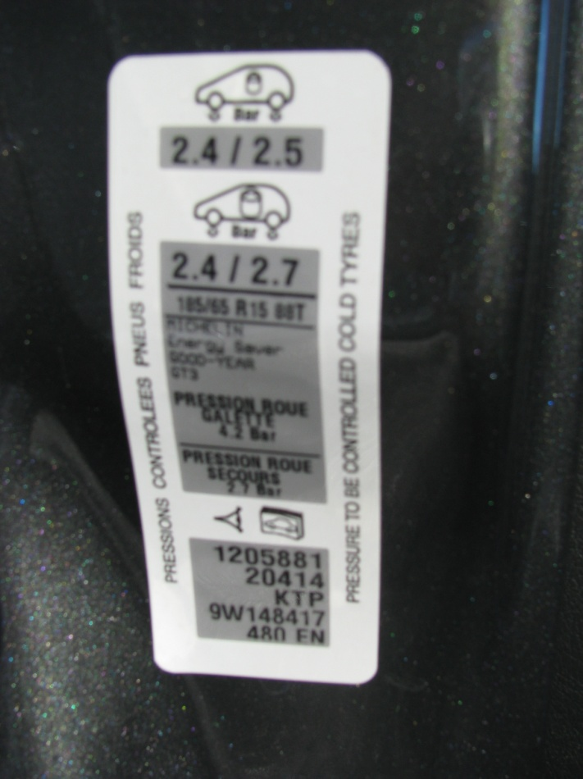
PEUGEOT
MODEL |  |  |  | POSITION OF COLOUR LABEL
ALL MODELS |  |  |  | ON THE FRONT DOOR EDGE
COLOUR CODE

Slide 49

PLYMOUTH
MODEL |  |  |  | POSITION OF COLOUR LABEL
ALL MODELS |  |  |  | IN THE ENGINE COMPARTMENT
COLOUR CODE
PICTURE NOT CURRENTLY AVAILABLE

Slide 50

PONTIAC
MODEL |  |  |  | POSITION OF COLOUR LABEL
ALL MODELS |  |  |  | ON THE SERVICE PARTS IDENTIFICATION STICKER
COLOUR CODE
PICTURE NOT CURRENTLY AVAILABLE

Slide 51
PORSCHE
MODEL |  |  |  | POSITION OF COLOUR LABEL
ALL MODELS (EXCEPT CAYENNE) |  |  |  | ON THE FRONT DOOR EDGE
CAYENNE |  |  |  | INSIDE THE BOOT
“ALSO CHECK” |  |  |  | INSIDE THE ENGINE COMPARTMENT
COLOUR CODE
COLOUR CODE
CAYENNE

Slide 52
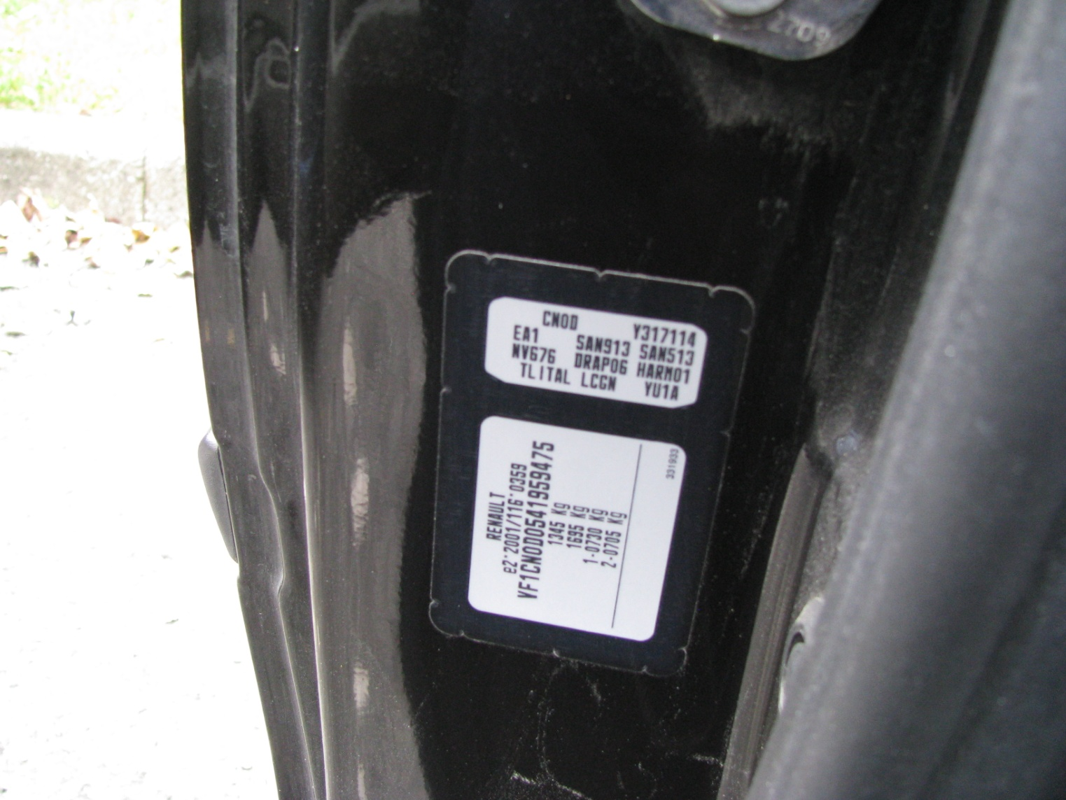
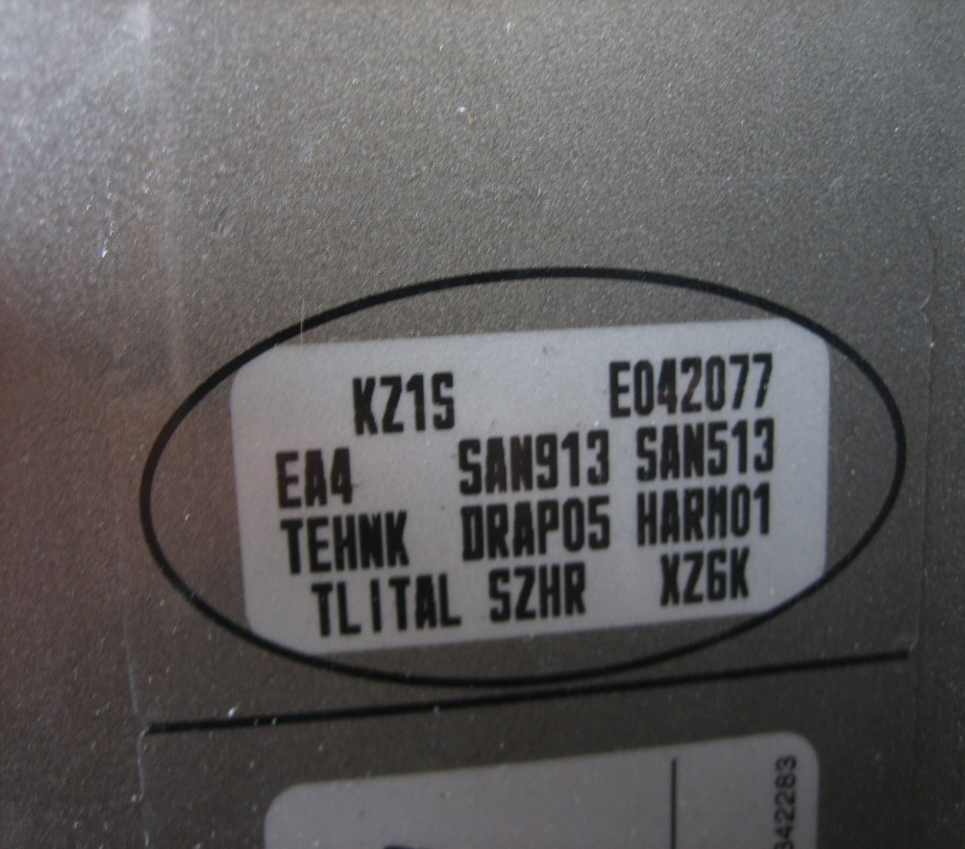
RENAULT
MODEL |  |  |  | POSITION OF COLOUR LABEL
ALL MODELS |  |  |  | ON THE FRONT DOOR COLUMN
COLOUR CODE
COLOUR CODE

Slide 53
SAAB
MODEL |  |  |  | POSITION OF COLOUR LABEL
ALL MODELS (EXCEPT 9-5) |  |  |  | IN THE GLOVE COMPARTMENT
9-5 |  |  |  | ON THE FRONT DOOR SHUTS
“ALSO CHECK” |  |  |  | INSIDE THE ENGINE COMPARTMENT
COLOUR CODE

Slide 54

SATURN
MODEL |  |  |  | POSITION OF COLOUR LABEL
ALL MODELS |  |  |  | ON THE SERVICE PARTS IDENTIFICATION STICKER
COLOUR CODE
PICTURE NOT CURRENTLY AVAILABLE

Slide 55
SEAT
MODEL |  |  |  | POSITION OF COLOUR LABEL
ALL MODELS |  |  |  | IN THE BOOT
“ALSO CHECK” |  |  |  | INSIDE THE ENGINE COMPARTMENT
COLOUR CODE

Slide 56

SCION
MODEL |  |  |  | POSITION OF COLOUR LABEL
ALL MODELS |  |  |  | ON THE FRONT DOOR COLUMN
COLOUR CODE
PICTURE NOT CURRENTLY AVAILABLE

Slide 57
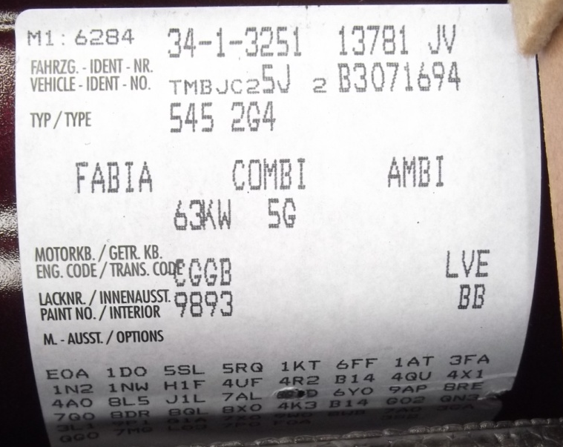
SKODA
MODEL |  |  |  | POSITION OF COLOUR LABEL
ALL MODELS |  |  |  | IN THE BOOT
“ALSO CHECK” |  |  |  | INSIDE THE ENGINE COMPARTMENT
COLOUR CODE

Slide 58
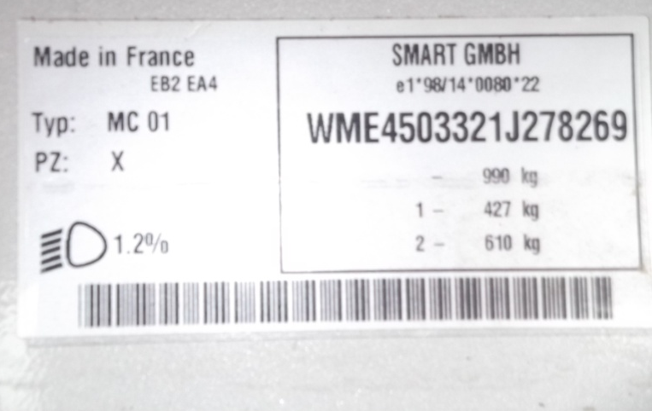
SMART
MODEL |  |  |  | POSITION OF COLOUR LABEL
FORTWO (Old Model) |  |  |  | INSIDE THE ENGINE COMPARTMENT (REAR)
FORTWO (New Model) FORFOUR |  |  |  | ON THE FRONT DOOR COLUMN
COLOUR CODE

Slide 59
SSANG YONG
MODEL |  |  |  | POSITION OF COLOUR LABEL
KORANDO - MUSSO - REXTON |  |  |  | INSIDE THE ENGINE COMPARTMENT
ACTYON - KYRON - REXTON 2 RODIUS |  |  |  | ON THE FRONT DOOR COLUMN
COLOUR CODE

Slide 60
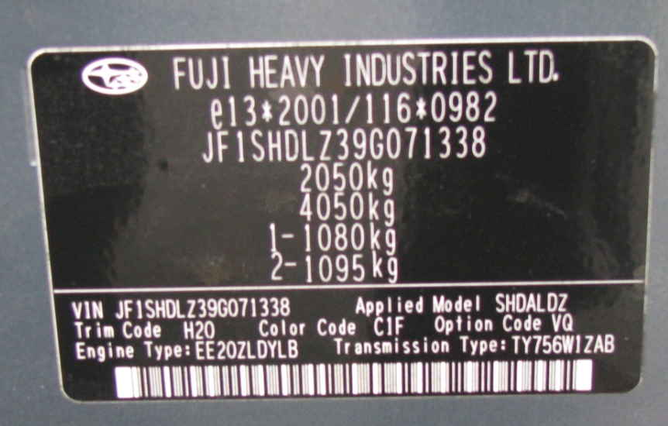
SUBARU
MODEL |  |  |  | POSITION OF COLOUR LABEL
FORESTER - OUTBACK |  |  |  | ON THE COLUMN / POST FRONT DOOR
“ALSO CHECK” |  |  |  | INSIDE THE ENGINE COMPARTMENT & INSIDE FRONT BUMPER
COLOUR CODE

Slide 61
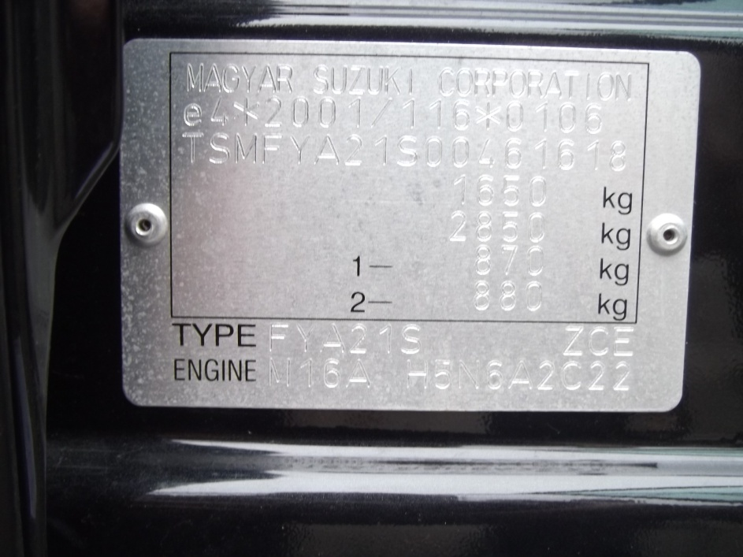
SUZUKI
MODEL |  |  |  | POSITION OF COLOUR LABEL
SPLASH – SWIFT |  |  |  | ON THE COLUMN / POST FRONT DOOR
GRAN VITARA - JIMNY VAGON - R SX4 |  |  |  | INSIDE THE ENGINE COMPARTMENT
SX4 - ALTO - CARRY |  |  |  | ON THE FRONT DOOR COLUMN
COLOUR CODE
COLOUR CODE

Slide 62
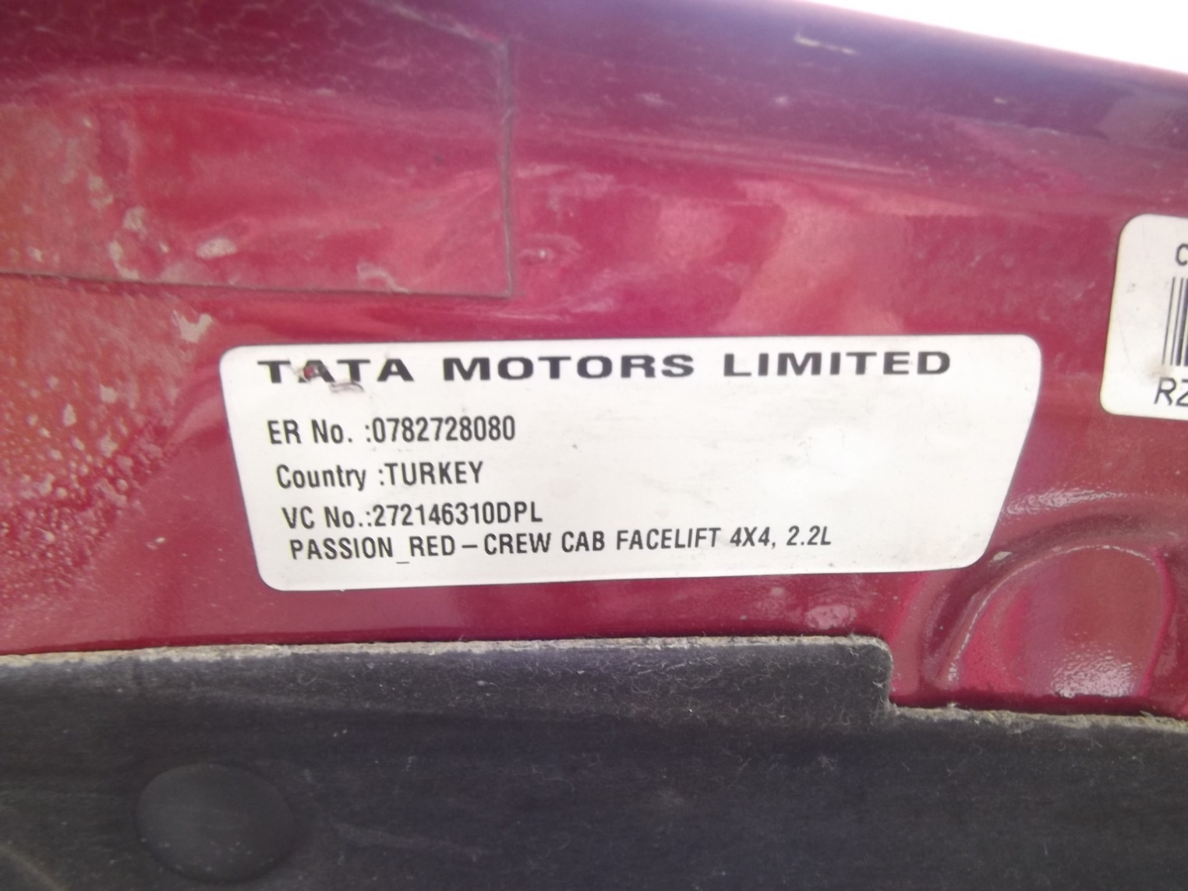
TATA
MODEL |  |  |  | POSITION OF COLOUR LABEL
ALL MODELS |  |  |  | ON THE ENGINE COMPARTMENT HOOD (bonnet)
COLOUR DESCRIPTION

Slide 63
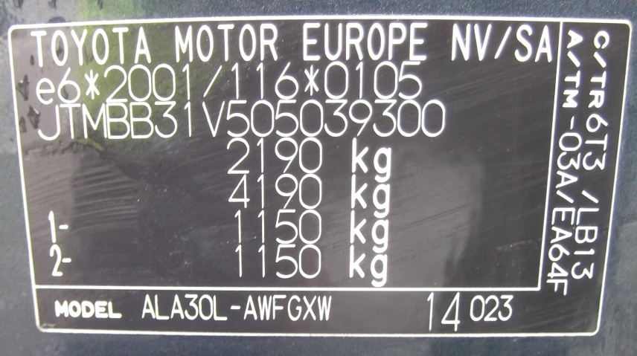
TOYOTA
MODEL |  |  |  | POSITION OF COLOUR LABEL
AYGO - AURIS - RAV4 - YARIS IQ - COROLLA - AVENSIS |  |  |  | ON THE FRONT DOOR SHUTS
RAV4 - AVENSIS - YARIS VERSO HILUX - HIACE - LAND CRUISER |  |  |  | INSIDE THE ENGINE COMPARTMENT
COLOUR CODE

Slide 64
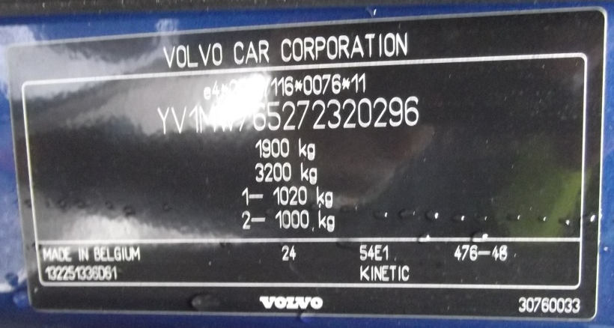
VOLVO
MODEL |  |  |  | POSITION OF COLOUR LABEL
XC90 - C70 - S40 - S60 S70 - S80 - V40 - V70 |  |  |  | INSIDE THE ENGINE COMPARTMENT
C30 - S40 - V50 - XC70 |  |  |  | ON THE REAR DOOR COLUMN
COLOUR CODE

Slide 65
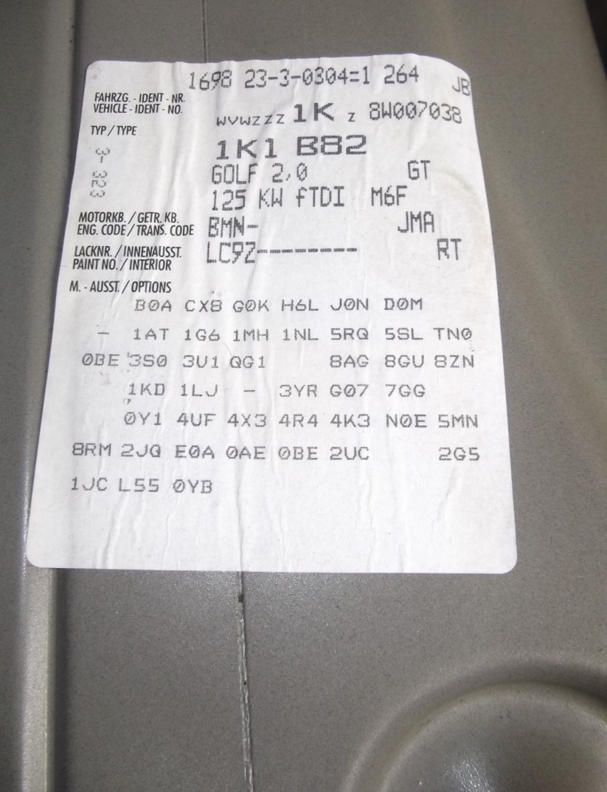
VOLKSWAGEN
MODEL |  |  |  | POSITION OF COLOUR LABEL
TOURAN 2010 |  |  |  | INSIDE THE BOOK "Use and Maintenance"
ALL MODELS |  |  |  | INSIDE THE BOOT
COLOUR CODE

