Slide 1
OEM COLOUR CODE LOCATIONS

Slide 2
OEM LOCATION
Acura C, P
Alfa Romeo A, F, K,
American Motors C, D, E, F, G, P
Aston Martin E
Bentley A, B, H, I, J, K, L
BMW C, F, H, I, J, P
Buick S
Cadillac S
Chevrolet I, Q
Chrysler I, K, L, M, O
Citroen C, D, N, P
Dacia A, C, F, K, P
Daewoo E, G, H, I, K
Dacia C, P
Daihatsu C, E, G, J, K, L, M, P
Datsun E, G, H, I, K
Dodge C, E, F, G, H, I, P
Eagle E, F, G, H, I, J, K, L
Ferrari A, G
Fiat A, B,C, H, J, K, L, P
Fiat Ulysse model D
Ford B, C, H, I, J, K, L, P
General Motors C, D, E, G J, K ,L, P, Q
GEO S
GMC C, N, P, Q
Honda C, G, H, K, P
Hummer Q
Hyundai C, E, P
Infiniti C, D, E, F, G, P
Isuzu C, E, G, J, K, L, P, Q
Jaguar C, J, K, L, P
Jeep D, E, F, G,
Kia C, D, H, J, K, P
OEM LOCATION
Lada A, B, I, K
Lamborghini F, K
Lancia A, B, D, E, G, H, J, K, L
Land & Range Rover C, H, J, K, P
Lexus D
Lincoln D
Lotus E, F, G, H, I
Maserati F, H, I, K
Mazda C, E, H, I, J, K, L, P
Mercedes-Benz C, D, G, I, J, K, L, P
Mercury D
Mini C, E, P
Mitsubishi C, H, I, J, K, P
MG D
Nissan C, I, J, K, L, P
Opel/Vauxhall A, B, C, E ,G, H, I, J, K, L, P
Peugeot C, D, P
Porsche A, B, C, D, I, J, K, L, P
Proton E, G, J, K, L
Renault C, P
Rover J, K, L
Saab C, G, I, P, Q
Seat A, B, I
Skoda A, B, G, I
SMART A, C, P
SsangYong C, F, J, K, P
Subaru C, J, K, L, M, P
Suzuki C, H, J, K, L, P
Tata K, L
Toyota C, E, G, J, P
Volvo C, E, G, H, J, K, L, P
VW/Audi B, R

Slide 3
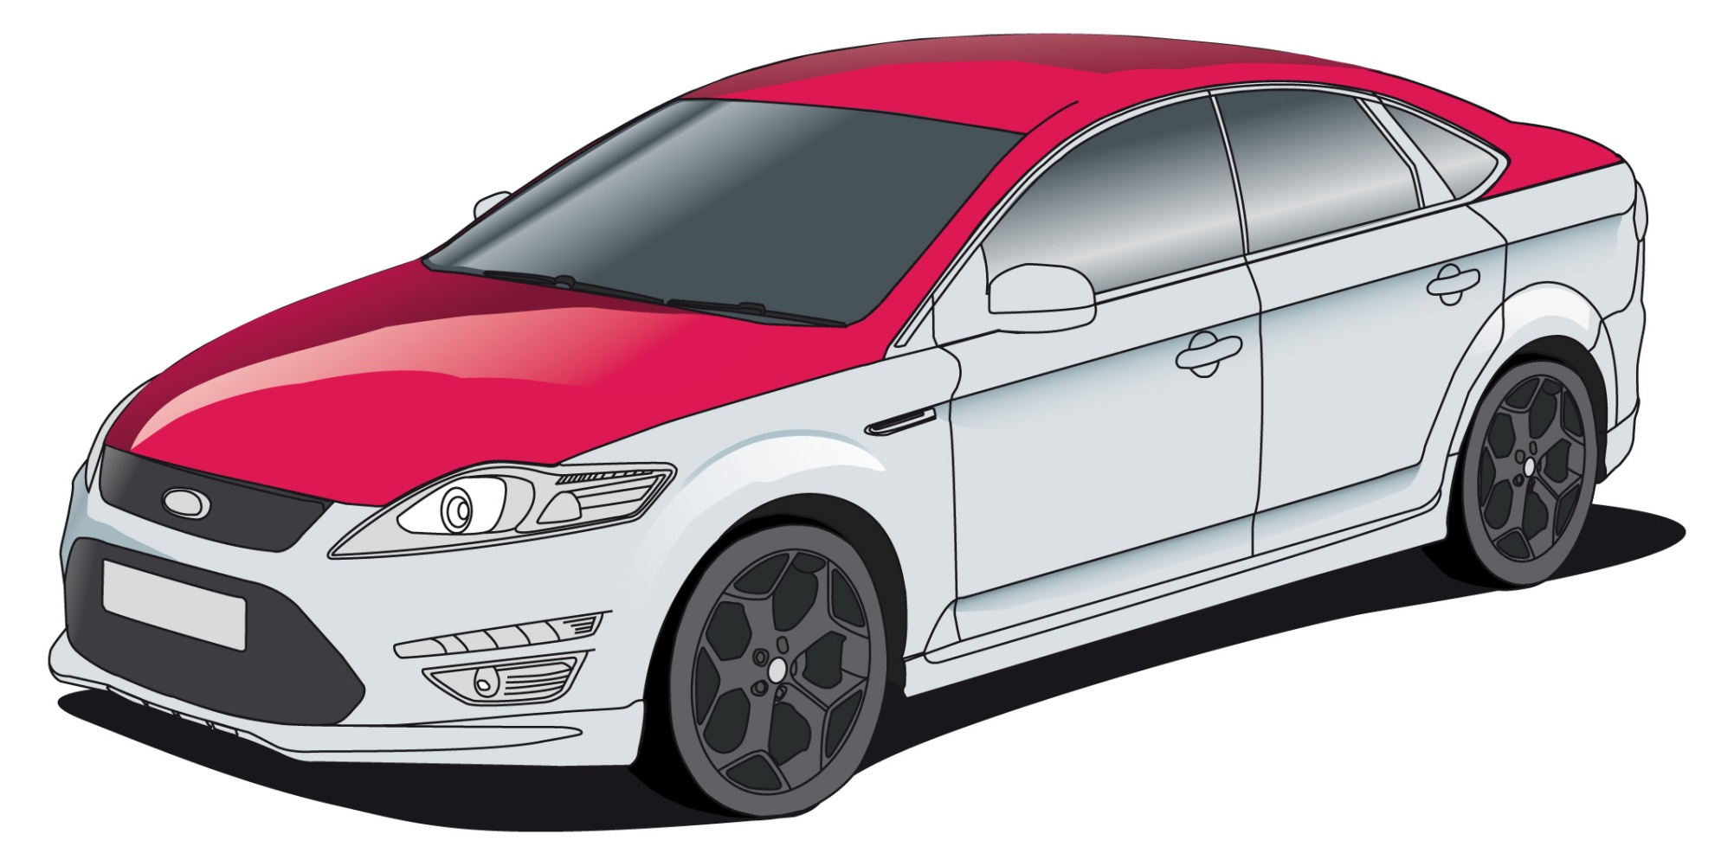
B
A
E
H
F
G
O
J
I
C
N
K
L
D
M

Slide 4
Q
R
P
Q
Glove box
R
Driver’s Information Manual
S
Service Parts Identification Sticker

